Slide 1
Adaptive and Bayesian Methods for Clinical Trial Design Short Course
Dr. Alex Kaizer
Master Protocol Designs
Notes:
xx

Slide 2
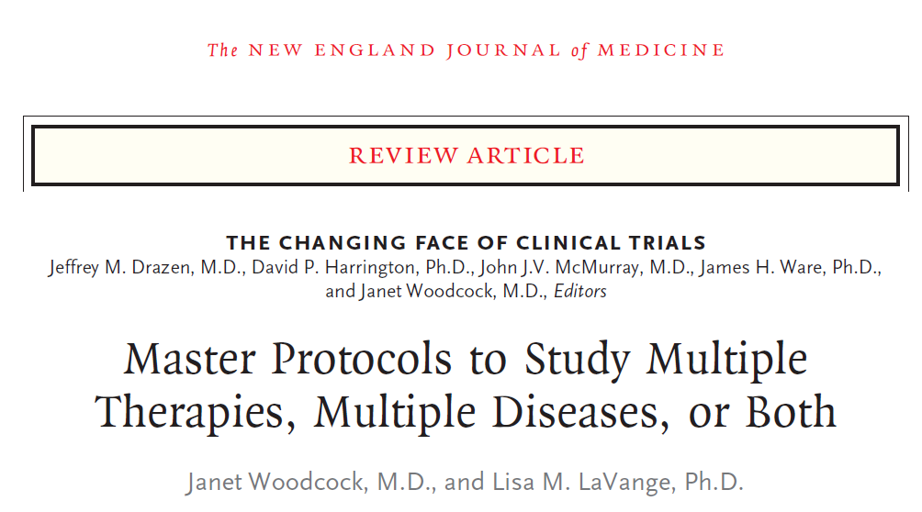


Overview Papers:

Slide 3
Background
New unifying design types for complex research questions

Slide 4
Master Protocols
Traditionally we have conducted separate standalone studies for at most a few interventions in targeted populations, however these are becoming increasingly expensive and prohibitive
Precision medicine and the need for flexible designs to consider multiple drugs, diseases, populations, or combinations of these are needed
Master protocols provide a unifying framework that use one master protocol for a study that is designed to answer multiple questions

Slide 5
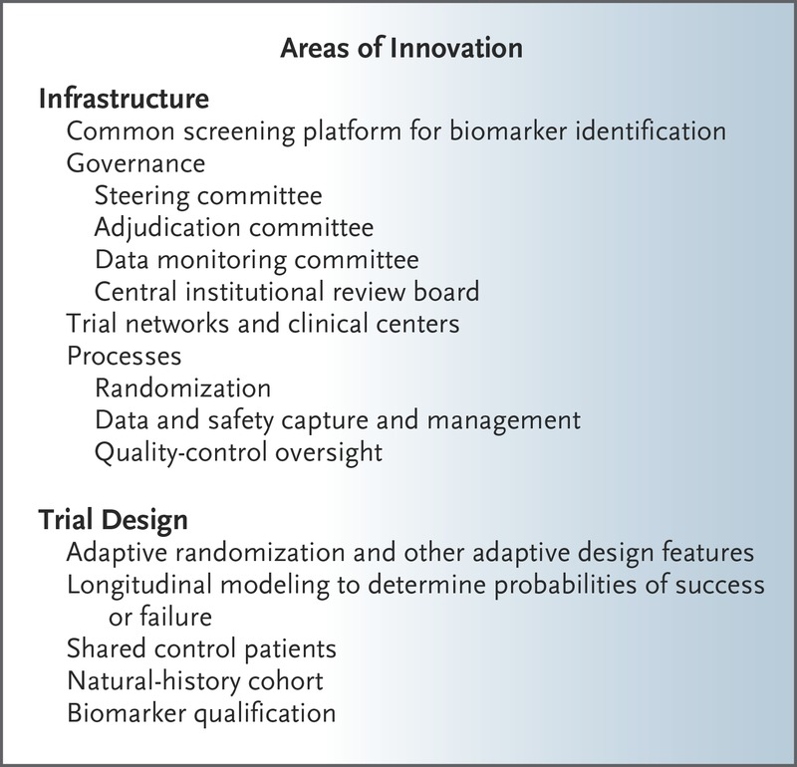
MP Innovation
Woodcock and LaVange describe the many areas of innovation that can be found in master protocols

Slide 6
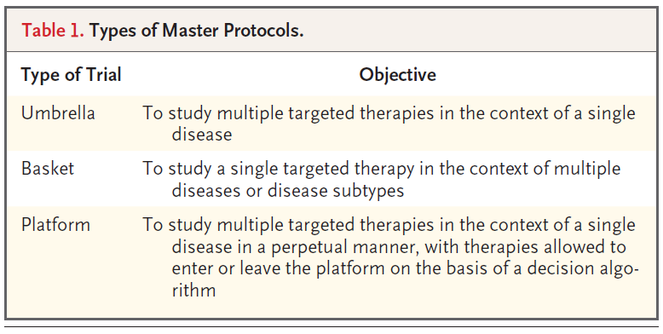
General Types of Master Protocols
Notes:
Woodcock, Janet, and Lisa M. LaVange. "Master protocols to study multiple therapies, multiple diseases, or both." New England Journal of Medicine 377.1 (2017): 62-70.

Slide 7
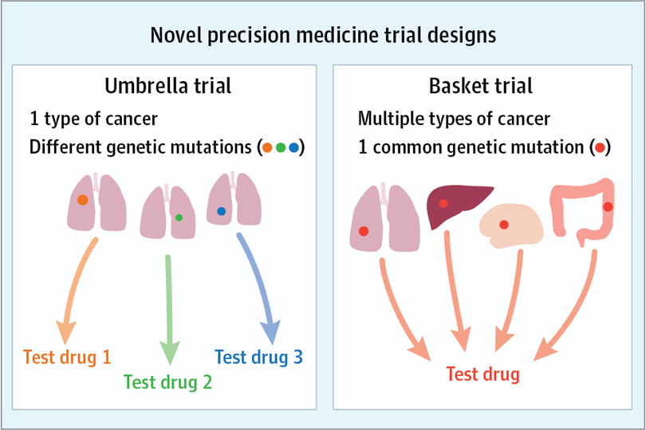
Umbrellas and Baskets
Umbrella trials identify a single (broad) disease, but then further classified by subtypes and treated accordingly
Basket trials identify a common mutation (or trait) across sites and then treat all with a common intervention
Notes:
Image: https://jamanetwork.com/journals/jamaoncology/fullarticle/2591161
West, Howard Jack. "Novel precision medicine trial designs: umbrellas and baskets." JAMA oncology 3.3 (2017): 423-423.

Slide 8
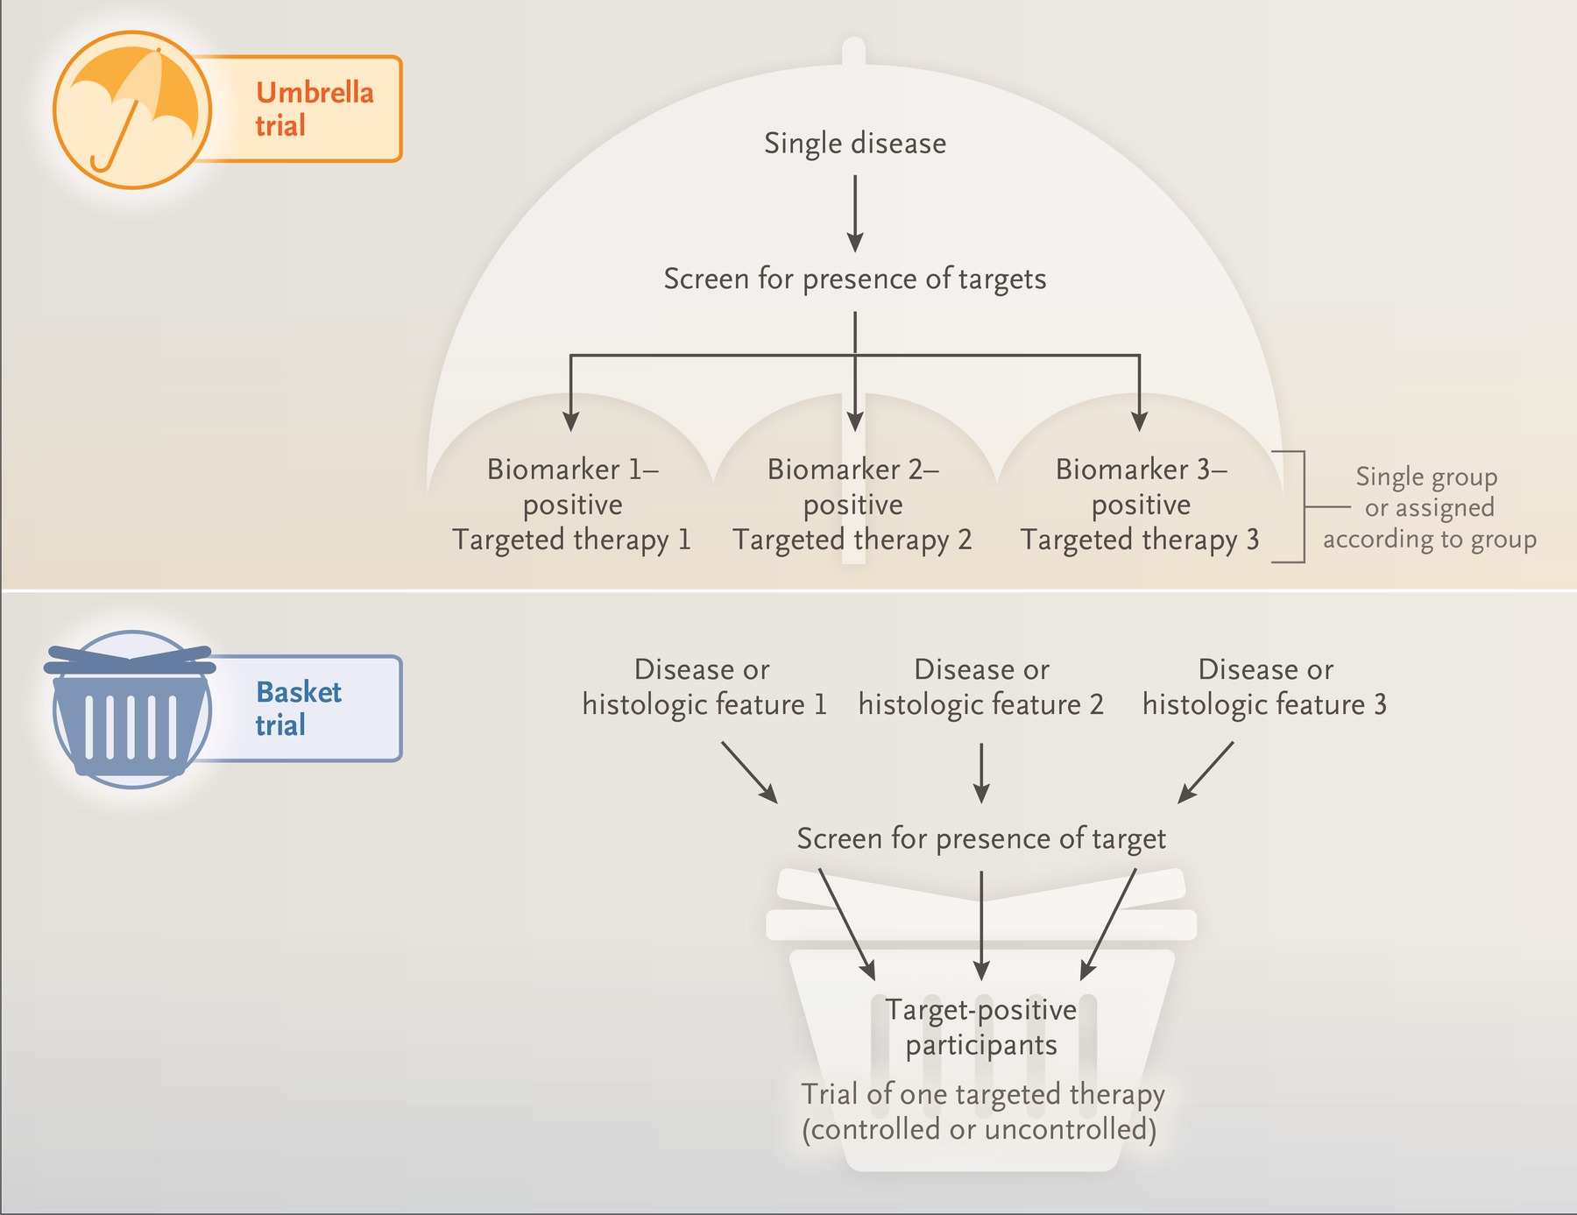
Another example figure of basket and umbrella designs (Figure 1 from Woodcock and LaVange)
Notes:
https://www.nejm.org/doi/full/10.1056/NEJMra1510062

Slide 9
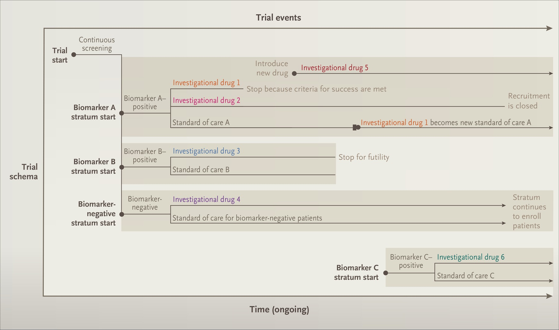
Platform Trials
Platform designs can be very flexible and potentially complex (Figure 2 from Woodcock and LaVange)
Notes:
Image: https://www.nejm.org/doi/full/10.1056/NEJMra1510062

Slide 10
Master Protocols
Designs can be noncomparative or comparative
If comparative, you may have a common control group or multiple control groups depending on design
Designs can include adaptive elements or not
Designs can be exploratory or confirmatory
LOTS of flexibility

Slide 11
Statistical Considerations for Master Protocols

Slide 12
The Move to Precision Medicine in Oncology
Traditionally, studies designed for a particular histology or “indication”
Therapies that target particular genetic alterations have been developed
Partition cancers into many small molecular subtypes
Potential heterogeneity in treatment benefit by indication

Slide 13
Statistical Challenges
Master protocols provide a flexible approach to designs with multiple indications, but have their own challenges (Woodcock and LaVange, 2017; Hobbs et al., 2018)
Often, we have small n for each indication (e.g., basket)
Indication/subgroup heterogeneity
Designing multi-indication studies generally requires optimizing for one scenario

Slide 14
Statistical Considerations
Subgroup Analyses
Type I Error Rate
Strength of Type I Error Control

Slide 15




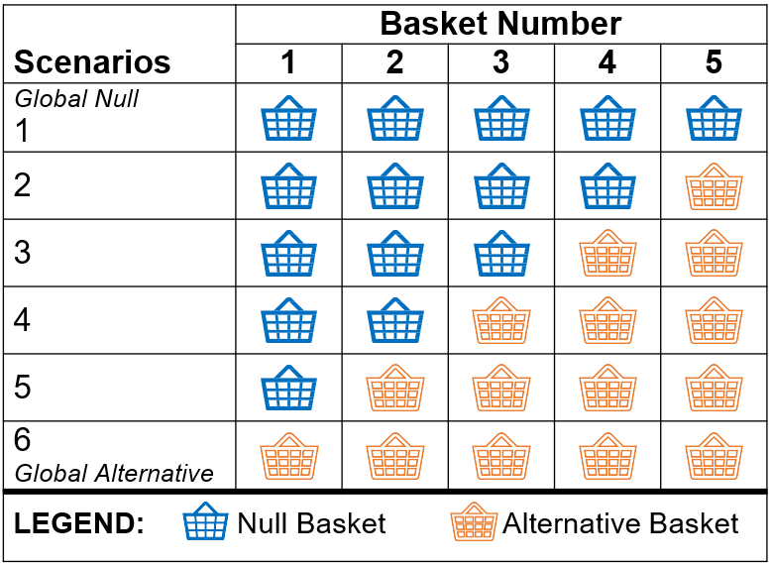
Motivating Example

Slide 16
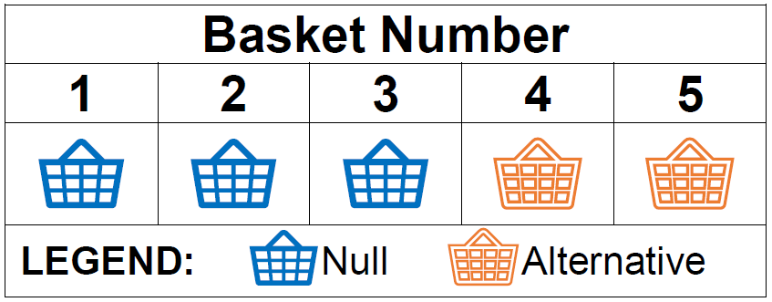
Statistical Considerations
Subgroup Analysis:
Pooled (combine all 5 baskets)
Independent (analyze each separately)
Information sharing between baskets

Slide 17
Statistical Considerations
Type I Error Rate:
Marginal (basket-specific)
Family-wise (consider all basket outcomes)

Slide 18
Statistical Considerations
Strength of Type I Error Control:
Weak (family-wise type I error for global null)
Strong (family-wise type I error for any scenario)

Slide 19
Statistical Considerations Notes
There is no one right combination for all studies
The context matters for what approach(es) you consider
Early phase trials may be more exploratory and focus on marginal type I error control
Later phase trials may be more confirmatory and focus on family-wise type I error control
Subgroup analyses may be driven by biological/clinical knowledge, practical considerations with data sources (e.g., similar study design and inclusion criteria), or regulatory guidance

Slide 20
Basket and Umbrella Case Studies

Slide 21
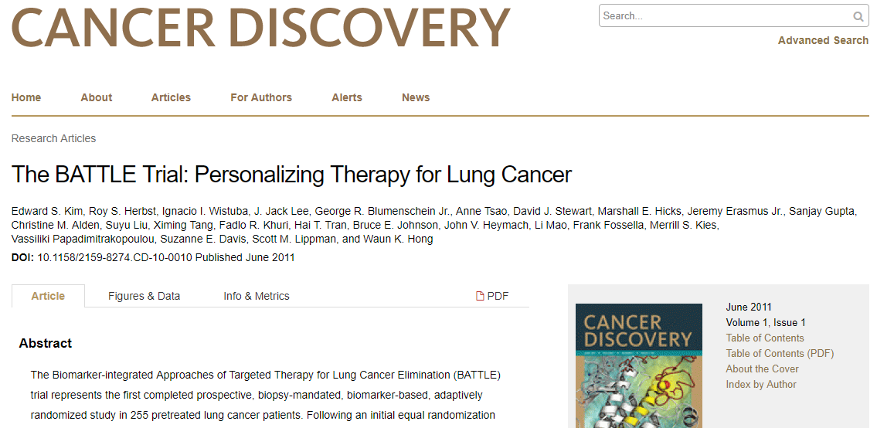
Umbrella Trial Example
Notes:
Kim, Edward S., et al. "The BATTLE trial: personalizing therapy for lung cancer." Cancer discovery 1.1 (2011): 44-53.

Slide 22
Umbrella Example: Study Design (BATTLE-1)
Outcome was complete or partial response, stable disease, progression free survival, overall survival, toxicity
Phase II, single-center, comparative trial with (response) adaptive randomization
Four therapies (three mono and one combination)
Study enrolled advanced NSCLC with specific mutations
255 adults who had at least 1 failed chemotherapy regimen
Notes:
Kim, Edward S., et al. "The BATTLE trial: personalizing therapy for lung cancer." Cancer discovery 1.1 (2011): 44-53.

Slide 23
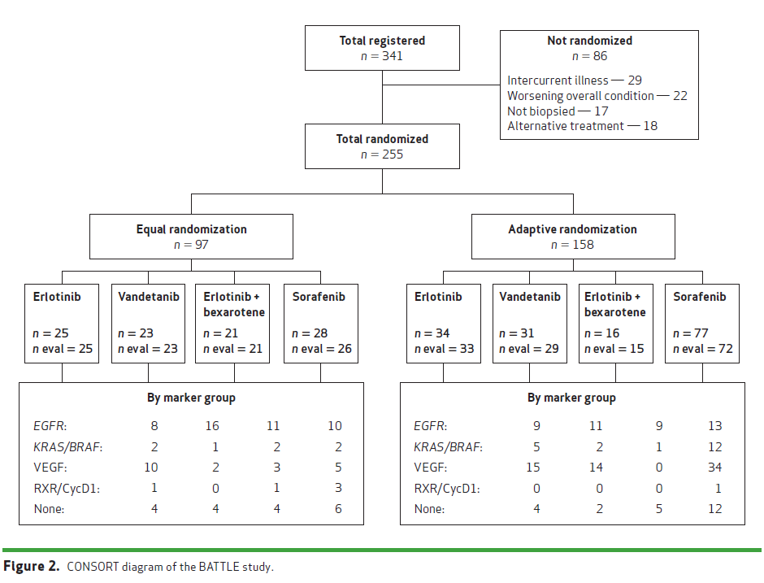
Umbrella Example cont.

Slide 24
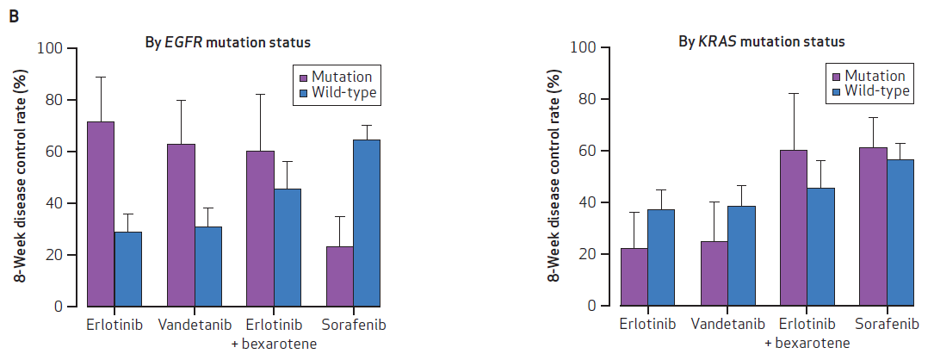
Umbrella Example: Conclusion
Demonstrated the feasibility of the umbrella design to advance personalized treatment of NSCLC
Different responses by mutation type and status:

Slide 25
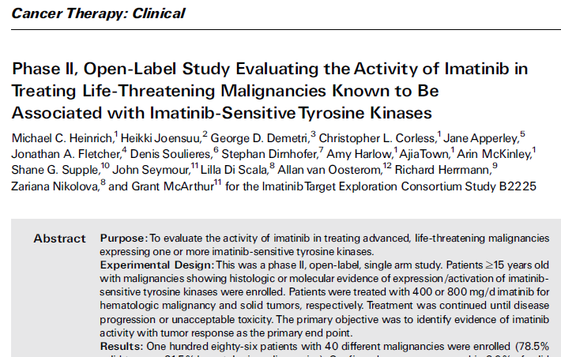
Basket Trial Example
Notes:
Heinrich, Michael C., et al. "Phase II, open-label study evaluating the activity of imatinib in treating life-threatening malignancies known to be associated with imatinib-sensitive tyrosine kinases." Clinical Cancer Research 14.9 (2008): 2717-2725.

Slide 26
Basket Example: Study Design
Outcome was tumor response to determine what cancers were responsive to imatinib
Phase 2, multicenter, open-label, noncomparative trial
Enrolled 40 cancers (solid tumors and hematologic cancers) with activation of imatinib target kinases
186 patients who were 15 years of age or older enrolled

Slide 27
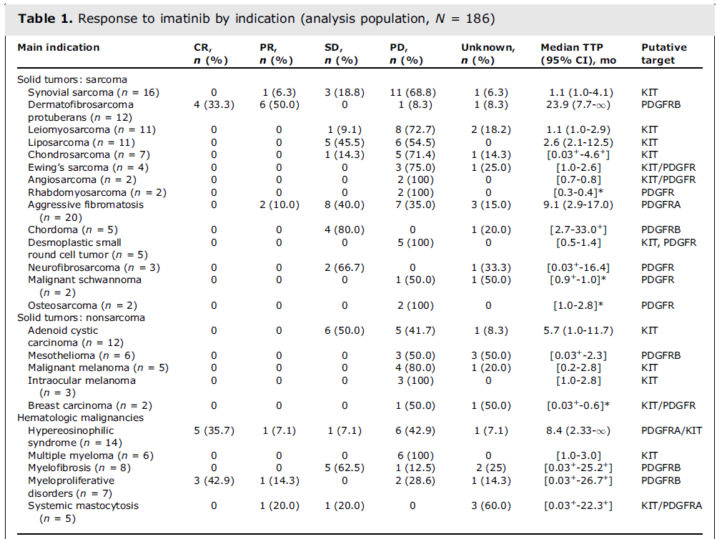
Small n in each indication leads to a statistical challenge:
Pool all data together and ignore subgroup effects?
Analyze indications separately with minimal power?

Slide 28
Basket Trial Example: Conclusion
Clinical benefit largely confined to indications with known genomic mechanisms
Used results to illustrate important role for molecular characterization of tumors to better identify patients who are more likely to benefit from imatinib

Slide 29
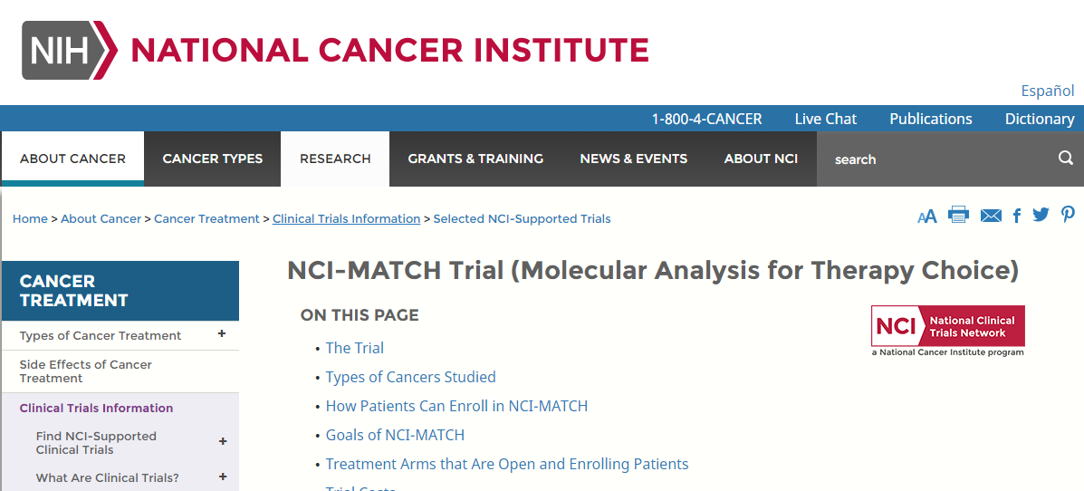
Umbrella/Basket Trial Example
Notes:
https://www.cancer.gov/about-cancer/treatment/clinical-trials/nci-supported/nci-match

Slide 30
Umbrella/Basket Example: Study Design
Outcome is tumor response and progression free survival
Attempting to determine if treating cancers according to molecular abnormalities is effective
Phase II, multicenter, noncomparative trial
Testing 30 treatments (as of May 2016) that are FDA approved or investigational that target gene abnormalities
Enrolling advanced solid tumors, lymphomas, or myeloma
Target of 35 adults per substudy, pediatric study began in 2017

Slide 31
Arm | Targeted Genetic Change | Drug(s)
A | EGFR mut | Afatinib
C2 | MET ex 14 sk | Crizotinib
E | EGFR T790M | AZD9291
F | ALK transloc | Crizotinib
G | ROS1 transloc | Crizotinib
J | HER2 amp | Trastuzumab, Pertuzumab
K1 | FGFR amp | Erdafitinib
K2 | FGFR mut or fusions | Erdafitinib
And more…
Notes:
Graphic: https://www.sciencedirect.com/science/article/pii/S009082581530175X?via%3Dihub and “Umbrella Trial_NCI Match” PDF

Slide 32
Platform Trial Case Study
A deep dive into a sequential Bayesian platform trial for Ebola, with a proposed modification to incorporate information sharing and adaptive randomization

Slide 33

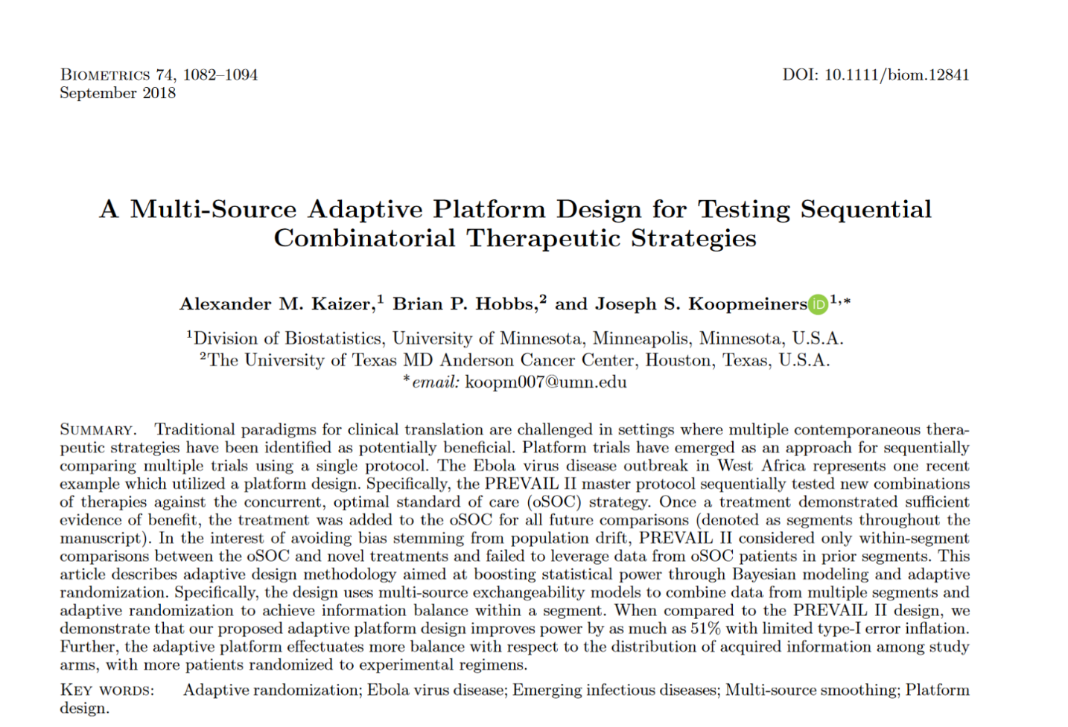
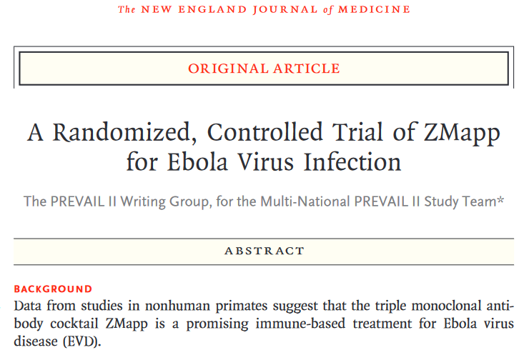
Relevant Papers

Slide 34
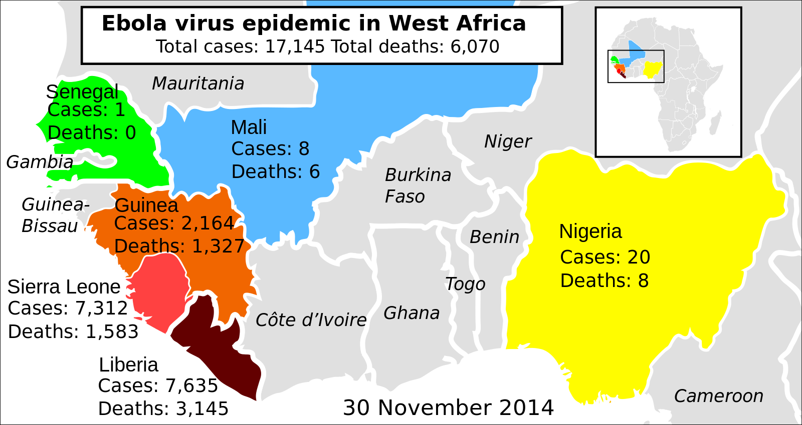
Ebola Virus Disease Outbreak
First cases recorded in Guinea in December 2013
Source: Mikael Ha¨ ggstro¨ m contribution to Wikimedia Commons

Slide 35
Platform Trial Design
NIH-sponsored Partnership for Research on Ebola Virus in Liberia II (PREVAIL II) (Dodd et al., 2016)
Sequentially considers multiple treatments within a single trial to most effectively identify beneficial therapeutics
PREVAIL II used a Bayesian design with frequent interim monitoring based on the posterior probability of increased survival in the treatment group
Primary outcome of 28-day mortality rate, assumed a Beta(1,1) prior

Slide 36
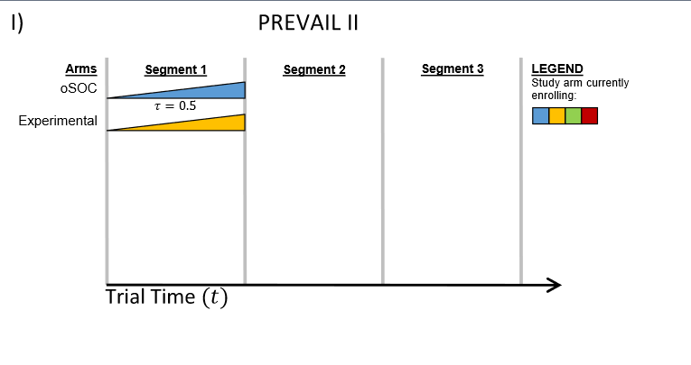
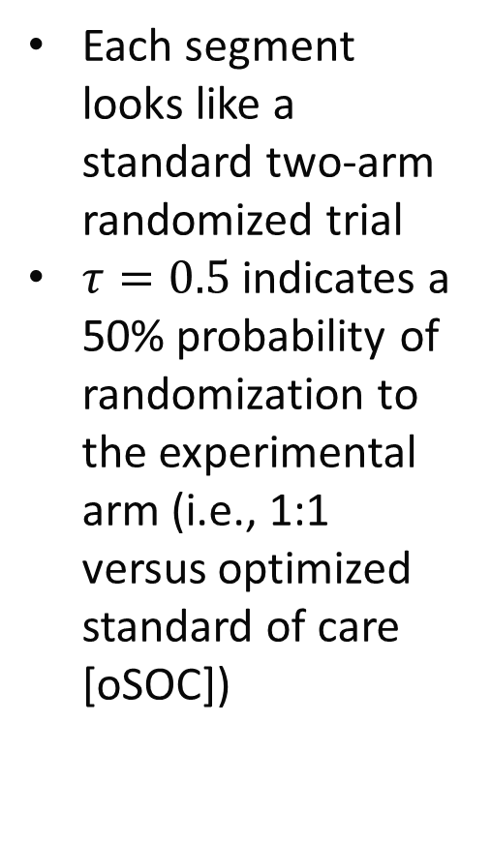
PREVAIL II Study Schematic
Each segment looks like a standard two-arm randomized trial
$τ=0.5$ indicates a 50% probability of randomization to the experimental arm (i.e., 1:1 versus optimized standard of care [oSOC])

Slide 37
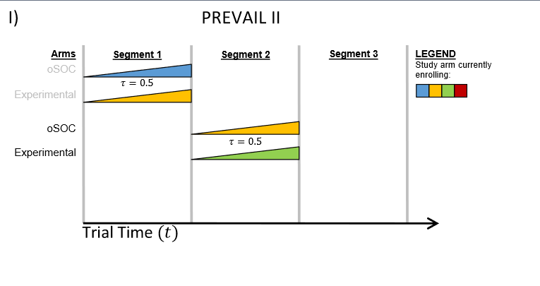
PREVAIL II Study Schematic
The “winner” from the first segment goes on to be the oSOC in the second segment

Slide 38
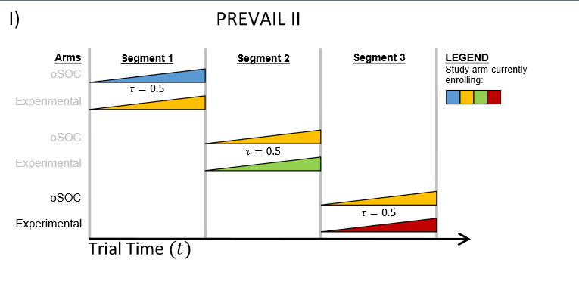
PREVAIL II Study Schematic
The winner of the 2nd segment becomes the oSOC for the 3rd segment
This trend can continue in perpetuity if possible or needed

Slide 39
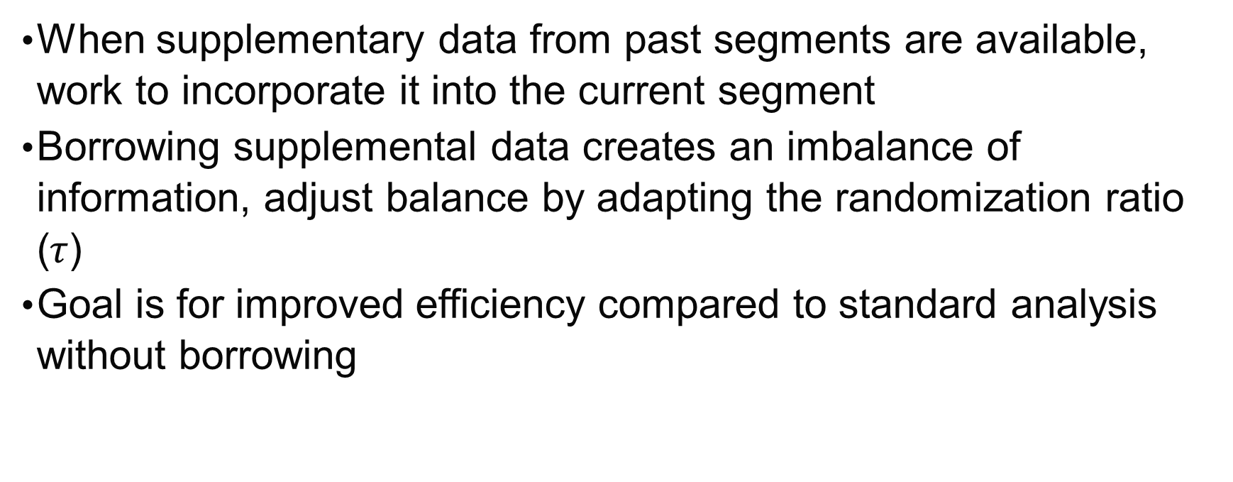
PREVAIL II Study Schematic Limitations
When supplementary data from past segments are available, work to incorporate it into the current segment
Borrowing supplemental data creates an imbalance of information, adjust balance by adapting the randomization ratio ($τ$)
Goal is for improved efficiency compared to standard analysis without borrowing

Slide 40
Multi-Source Exchangeability Models (MEMs)
General Bayesian framework to enable incorporation of independent sources of supplemental information (Kaizer et al., 2017)
Amount of borrowing determined by exchangeability of data (e.g., equivalent mortality rates)
MEMs account for the potential heterogeneity of supplementary sources

Slide 41
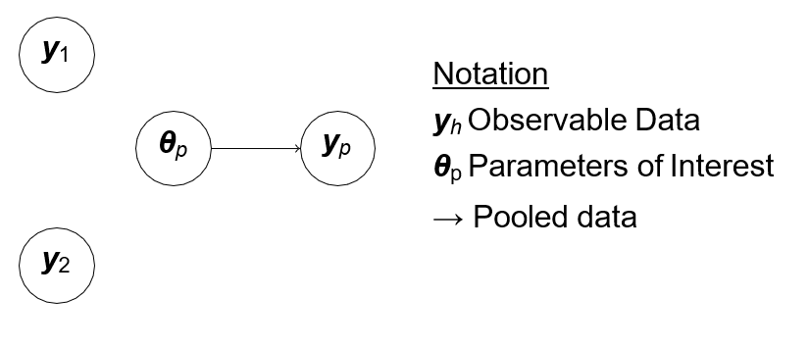
Standard Analysis (No Borrowing)

Slide 42
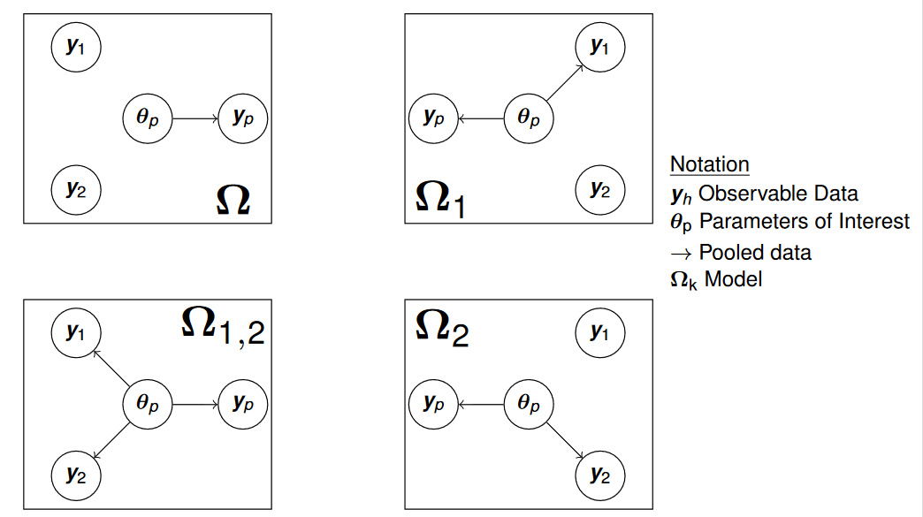
MEM Framework at Segment 3

Slide 43
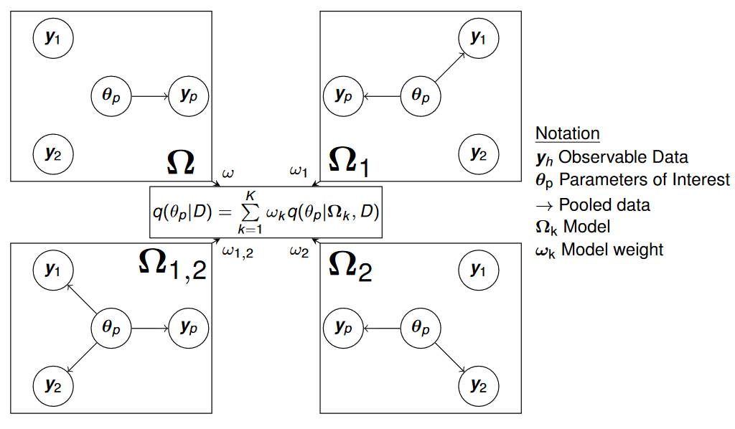
MEM Framework at Segment 3

Slide 44
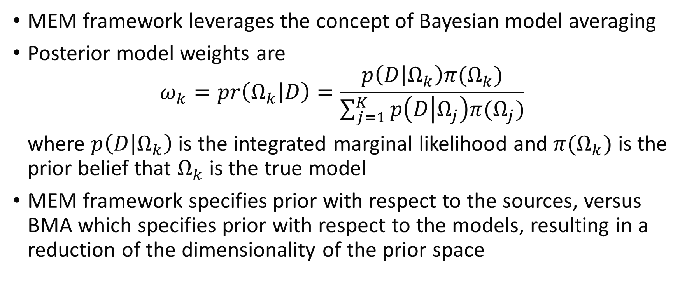
Building the MEM Framework
MEM framework leverages the concept of Bayesian model averaging
Posterior model weights are
$$ω_{k}=pr\left(Ω_{k} | D\right)=\frac{p\left(D | Ω_{k}\right)π(Ω_{k})}{\sum_{j=1}^{K}{p\left(D | Ω_{j}\right)π(Ω_{j})}}$$
where $p\left(D | Ω_{k}\right)$ is the integrated marginal likelihood and $π(Ω_{k})$ is the prior belief that $Ω_{k}$ is the true model
MEM framework specifies prior with respect to the sources, versus BMA which specifies prior with respect to the models, resulting in a reduction of the dimensionality of the prior space

Slide 45
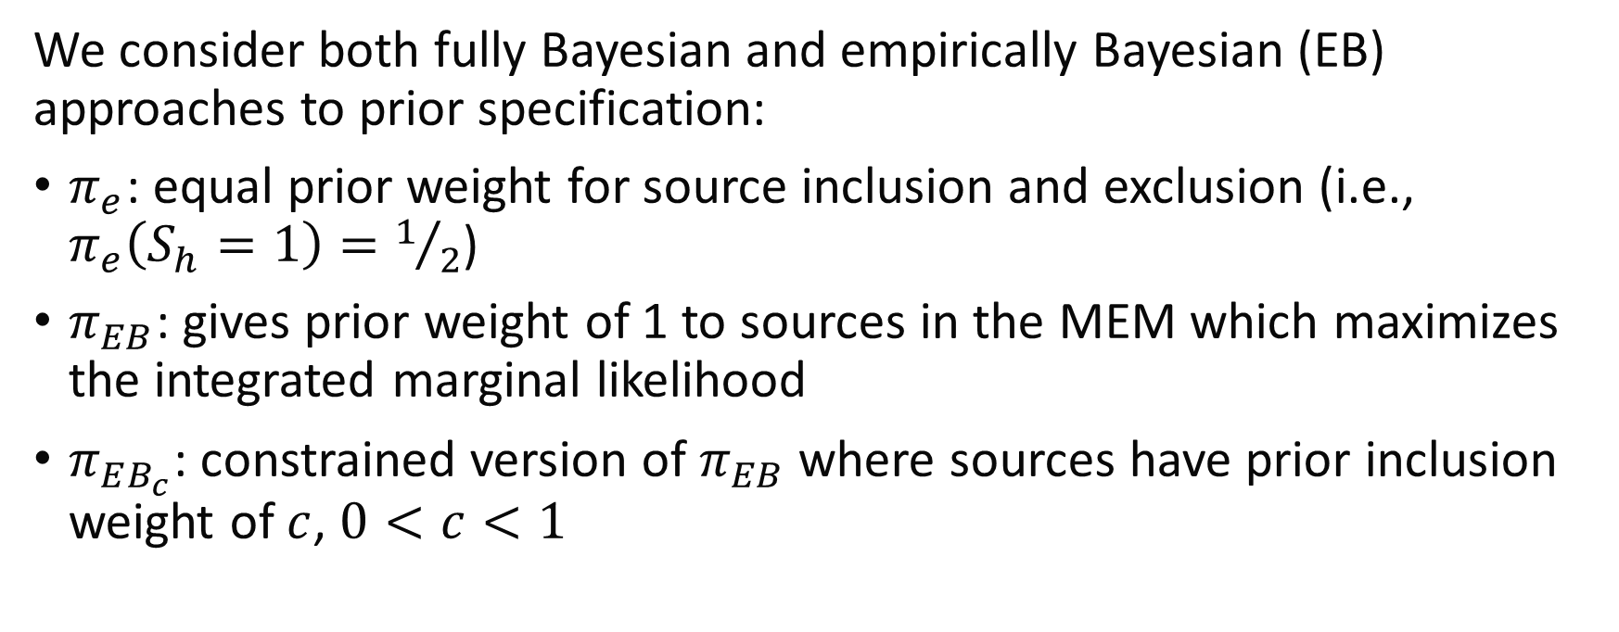
MEM Source Priors
We consider both fully Bayesian and empirically Bayesian (EB) approaches to prior specification:
$π_{e}$: equal prior weight for source inclusion and exclusion (i.e., $π_{e}\left(S_{h}=1\right)=1/2$)
$π_{EB}$: gives prior weight of 1 to sources in the MEM which maximizes the integrated marginal likelihood
$π_{EB_{c}}$: constrained version of $π_{EB}$ where sources have prior inclusion weight of $c$, $0<c<1$

Slide 46
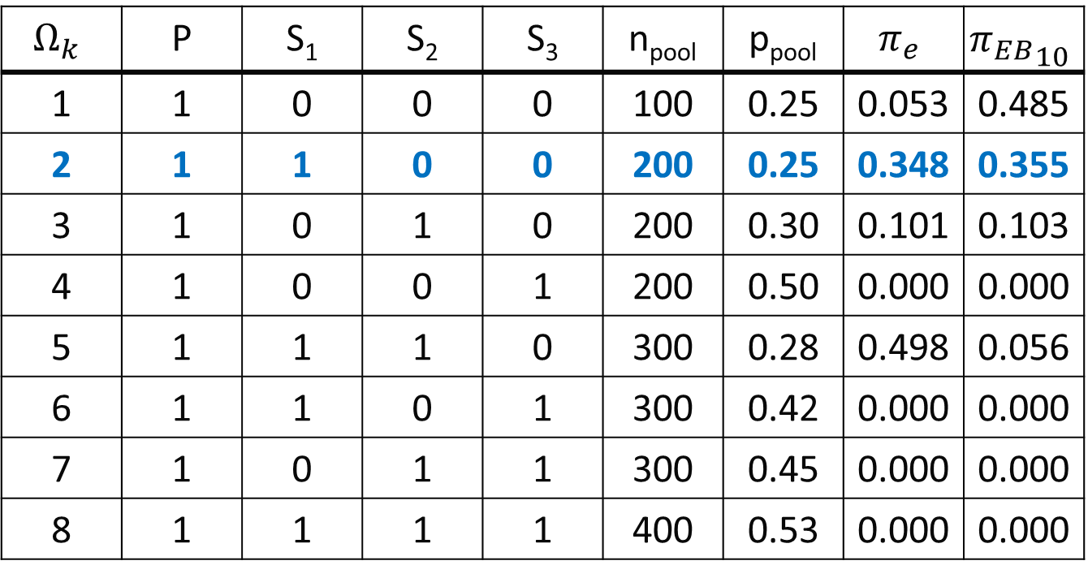
MEM Posterior Weights Example
Consider n=100 for each source and
p = 0.25
p₁ = 0.25
p₂ = 0.35
p₃ = 0.75
$$Ω_{k}$$ | P | S₁ | S₂ | S₃ | n_{pool} | p_{pool} | $$π_{e}$$ | $${π_{EB}}_{10}$$
1 | 1 | 0 | 0 | 0 | 100 | 0.25 | 0.053 | 0.485
2 | 1 | 1 | 0 | 0 | 200 | 0.25 | 0.348 | 0.355
3 | 1 | 0 | 1 | 0 | 200 | 0.30 | 0.101 | 0.103
4 | 1 | 0 | 0 | 1 | 200 | 0.50 | 0.000 | 0.000
5 | 1 | 1 | 1 | 0 | 300 | 0.28 | 0.498 | 0.056
6 | 1 | 1 | 0 | 1 | 300 | 0.42 | 0.000 | 0.000
7 | 1 | 0 | 1 | 1 | 300 | 0.45 | 0.000 | 0.000
8 | 1 | 1 | 1 | 1 | 400 | 0.53 | 0.000 | 0.000
Cover 1
Cover 2
Notes:
n_{pool} represents the sample size from pooling all groups with a 1 indicator
p_{pool} represents the estimated probability within each pooled MEM
pi_e and pi_EB_10 are the estimated model weights assigned to each configuration of exchangeability (i.e., MEM) based on the data and prior

Slide 47
Information Balance Adaptive Randomization
Incorporating supplemental data can lead to an imbalance of information and a loss of power
Can adapt the randomization ratio to maintain the balance of information across all sources
Extend the AR method proposed by Hobbs et al. (2013) to our sequential platform design

Slide 48
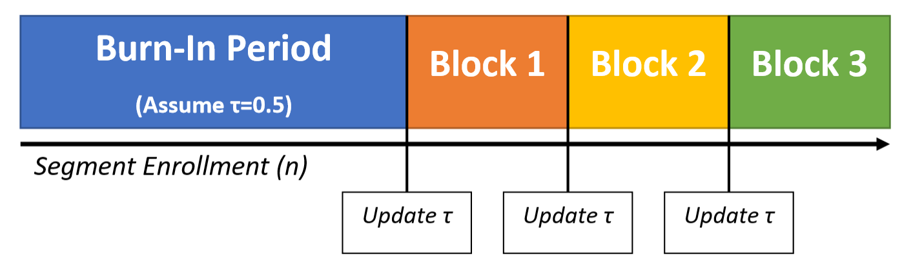
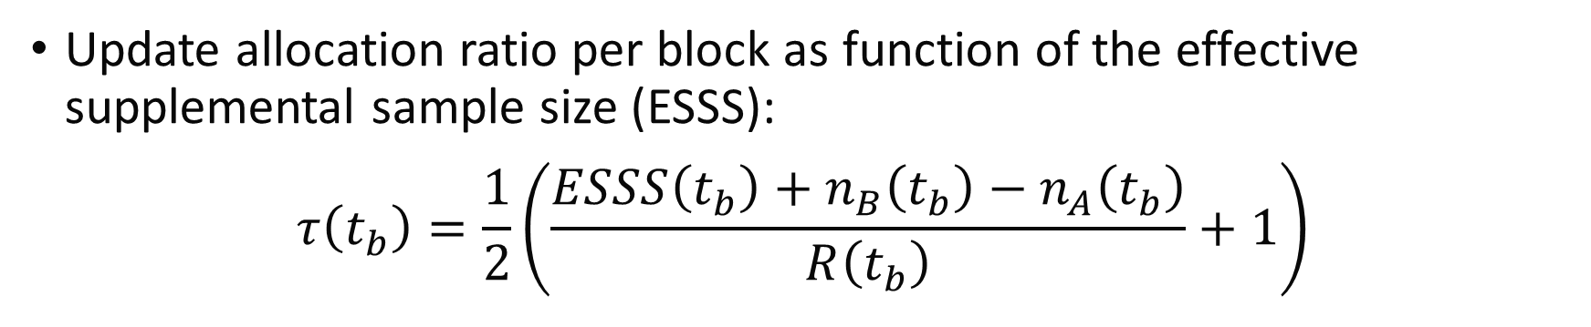
IBAR Schematic
Update allocation ratio per block as function of the effective supplemental sample size (ESSS):
$$τ\left(t_{b}\right)=\frac{1}{2}\left(\frac{ESSS\left(t_{b}\right)+n_{B}\left(t_{b}\right)−n_{A}\left(t_{b}\right)}{R\left(t_{b}\right)}+1\right)$$
Notes:
ESSS(t_{b}): effective supplemental sample size at time t_{b} (i.e., block 1/2/3/4/etc.)
n_{A}(t_{b}) and n_{B}(t_{b}) are the observed same sizes in Arm A and Arm B, respectively, at the block update
R(t_{b}) is the number left to enroll

Slide 49
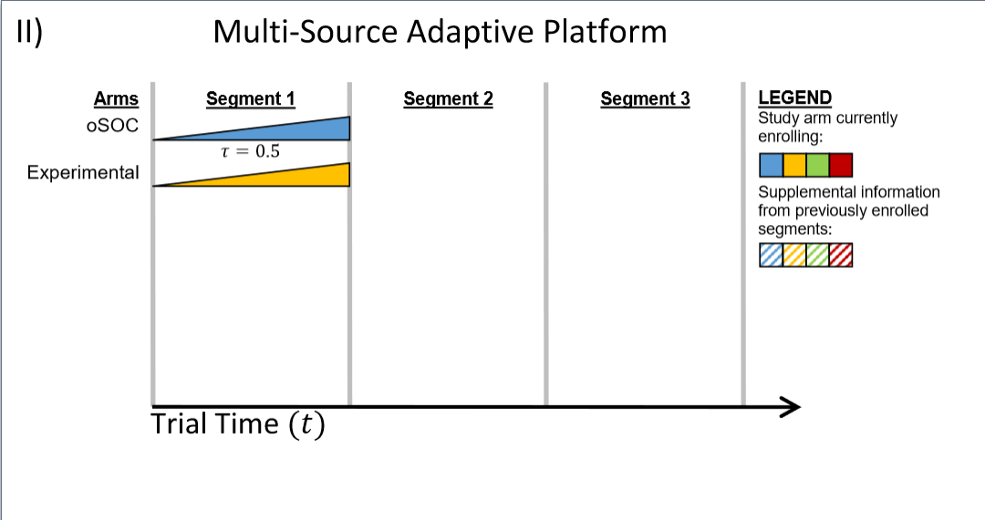
Proposed Adaptive Platform Design
First segment starts identical to original PREVAIL II design because no external data exist to incorporate

Slide 50
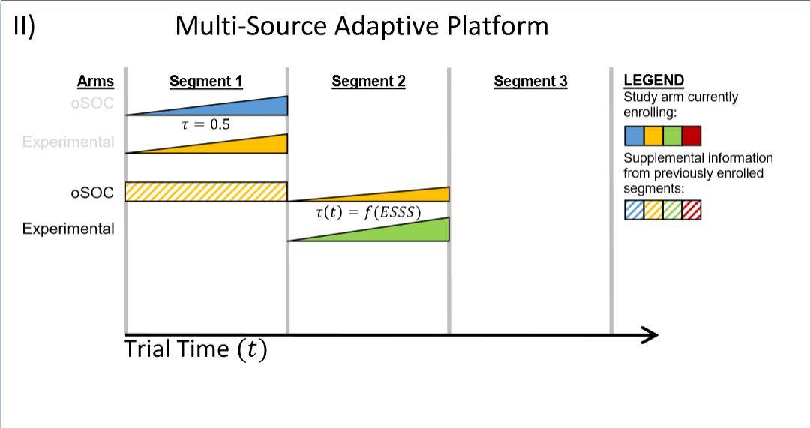
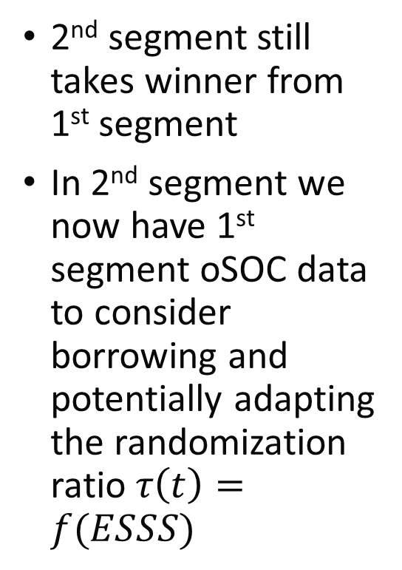
Proposed Adaptive Platform Design
2nd segment still takes winner from 1st segment
In 2nd segment we now have 1st segment oSOC data to consider borrowing and potentially adapting the randomization ratio $τ\left(t\right)=f(ESSS)$

Slide 51
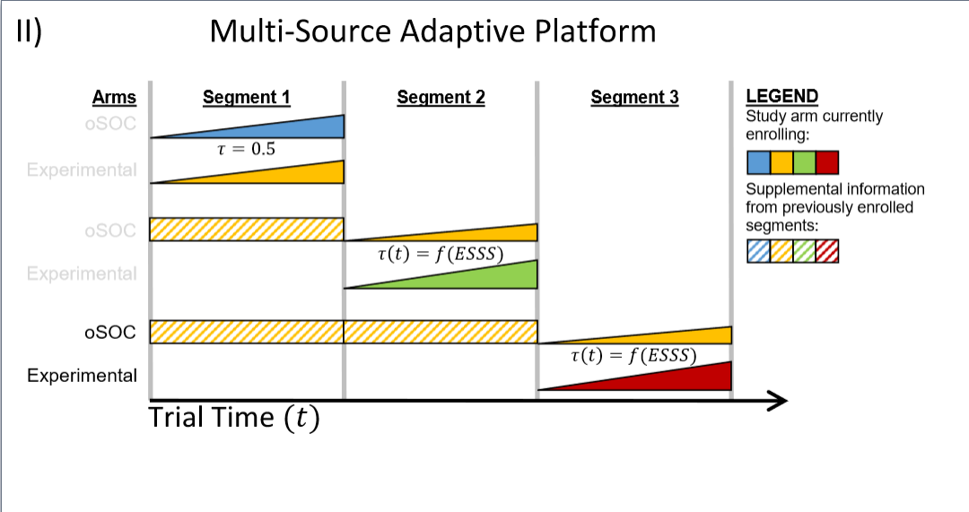
Proposed Adaptive Platform Design
Similar to PREVAIL II design, the pattern can continue in perpetuity
In 3rd segment, we now have 2 segments of past data to borrow from

Slide 52
Simulation Study
25,000 simulated trials for five segments (potential treatments) with up to 200 patients per segment
Data generated assuming an underlying mortality rate, p_{oSOC}
Mortality rate for each drug combination defined by multiplicative model of RR while assuming no interactions:
oSOC = p_{oSOC}
oSOC + Drug A = p_{oSOC} x RR_{A}
oSOC + Drug B = p_{oSOC} x RR_{B}
oSOC + Drug A + Drug B = p_{oSOC} x RR_{A} x RR_{B}

Slide 53
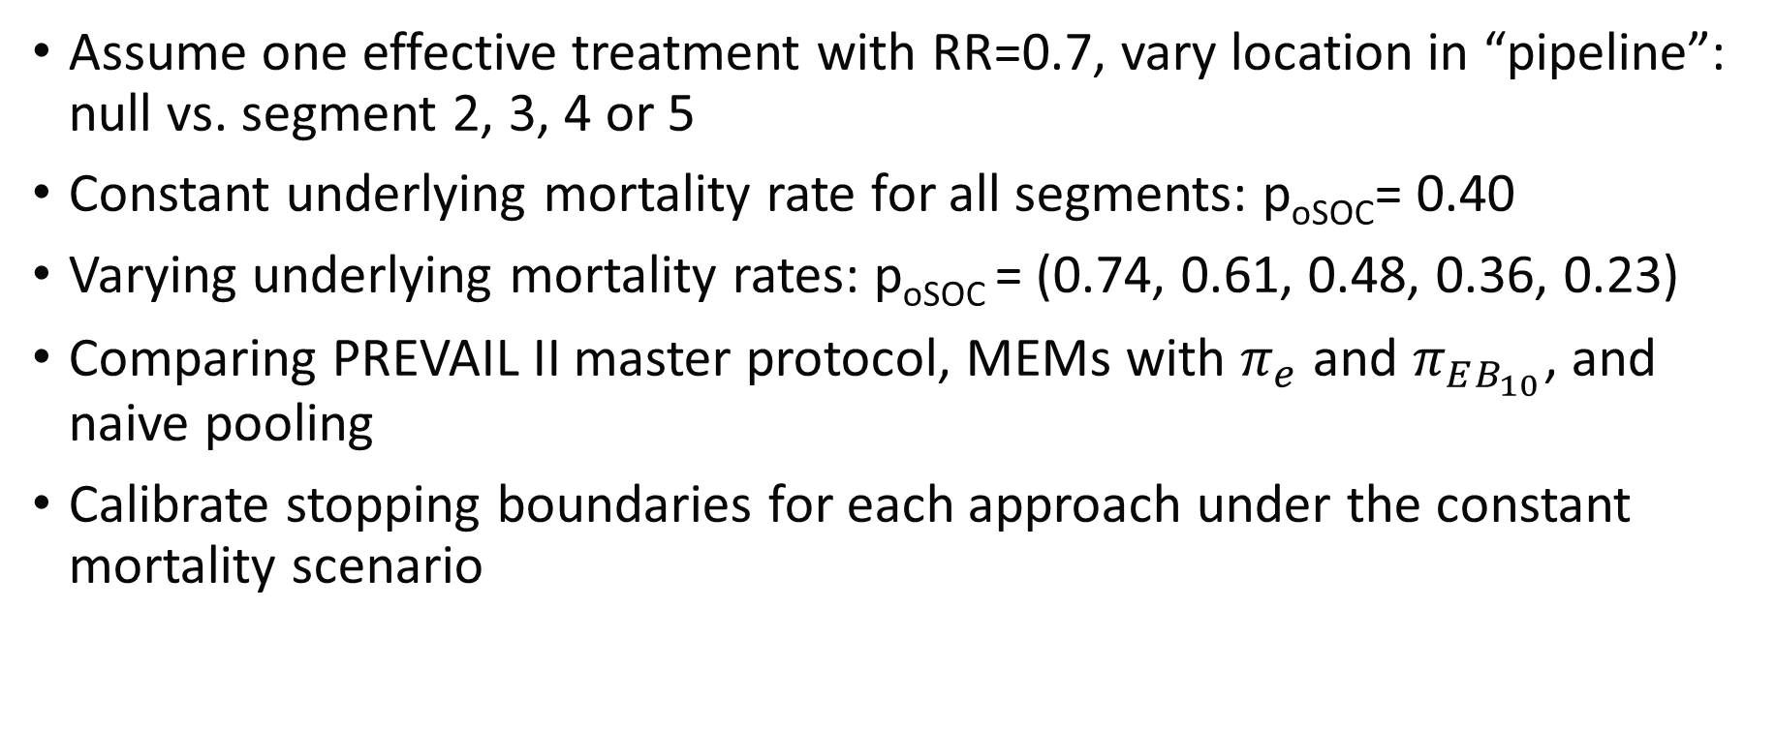
Simulation Study Scenarios
Assume one effective treatment with RR=0.7, vary location in “pipeline”: null vs. segment 2, 3, 4 or 5
Constant underlying mortality rate for all segments: p_{oSOC}= 0.40
Varying underlying mortality rates: p_{oSOC} = (0.74, 0.61, 0.48, 0.36, 0.23)
Comparing PREVAIL II master protocol, MEMs with $π_{e}$ and $π_{EB_{10}}$, and naive pooling
Calibrate stopping boundaries for each approach under the constant mortality scenario

Slide 54
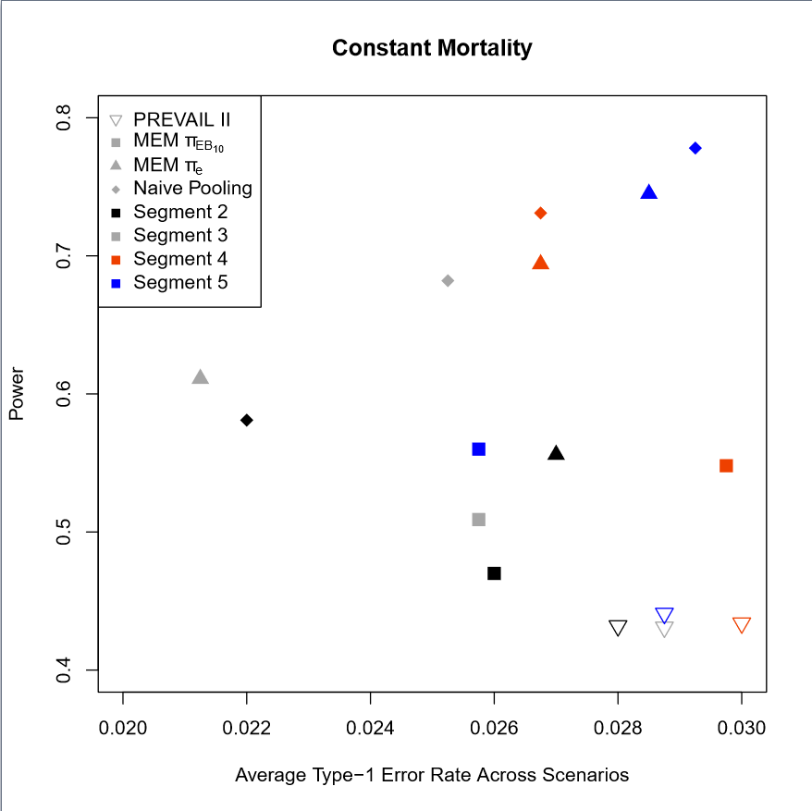
Constant Mortality - I
Figures present the average type I error rate across all null segments of the trial across the x-axis, power for the effective segment on the y-axis
Colors represent location of RR=0.7 treatment in pipeline
Shapes represent different methods

Slide 55
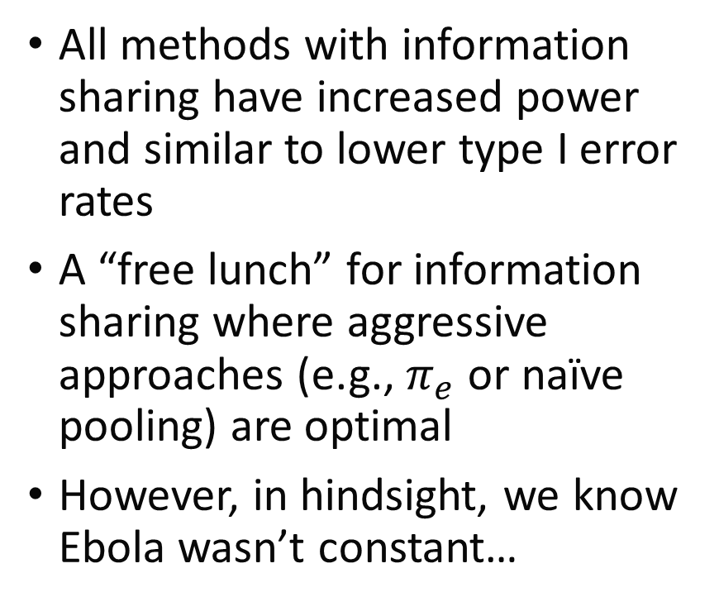
Constant Mortality - II
All methods with information sharing have increased power and similar to lower type I error rates
A “free lunch” for information sharing where aggressive approaches (e.g., $π_{e}$ or naïve pooling) are optimal
However, in hindsight, we know Ebola wasn’t constant…

Slide 56
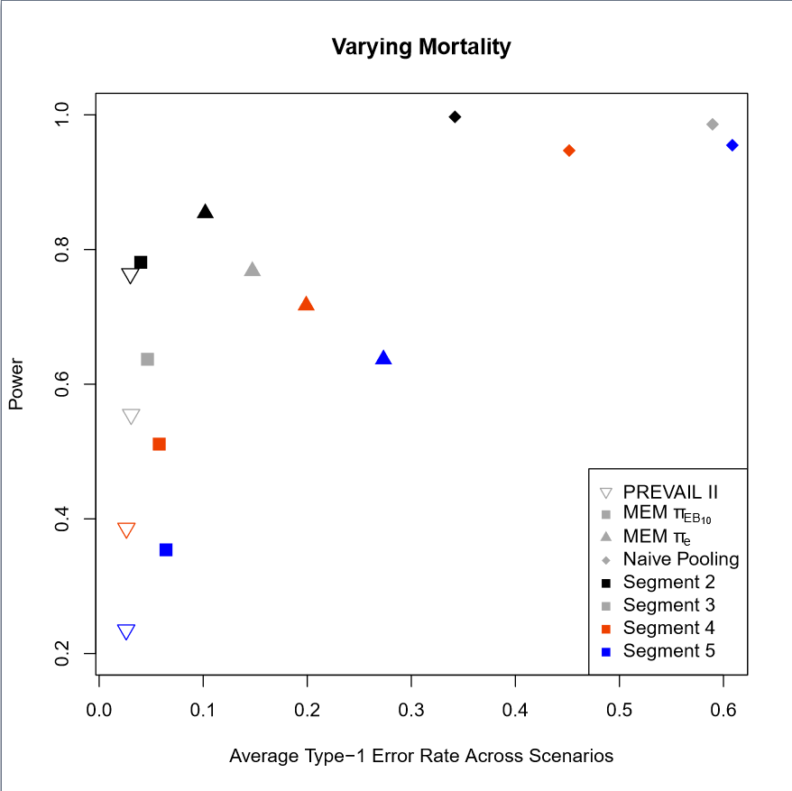
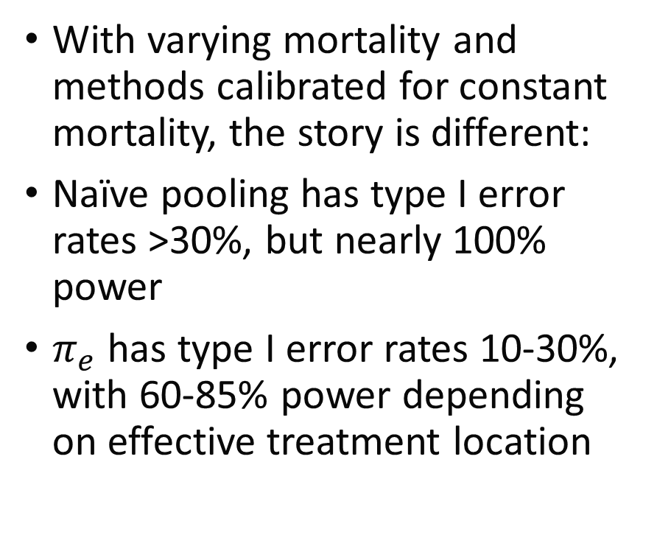
Varying Mortality - I
With varying mortality and methods calibrated for constant mortality, the story is different:
Naïve pooling has type I error rates >30%, but nearly 100% power
$π_{e}$ has type I error rates 10-30%, with 60-85% power depending on effective treatment location

Slide 57
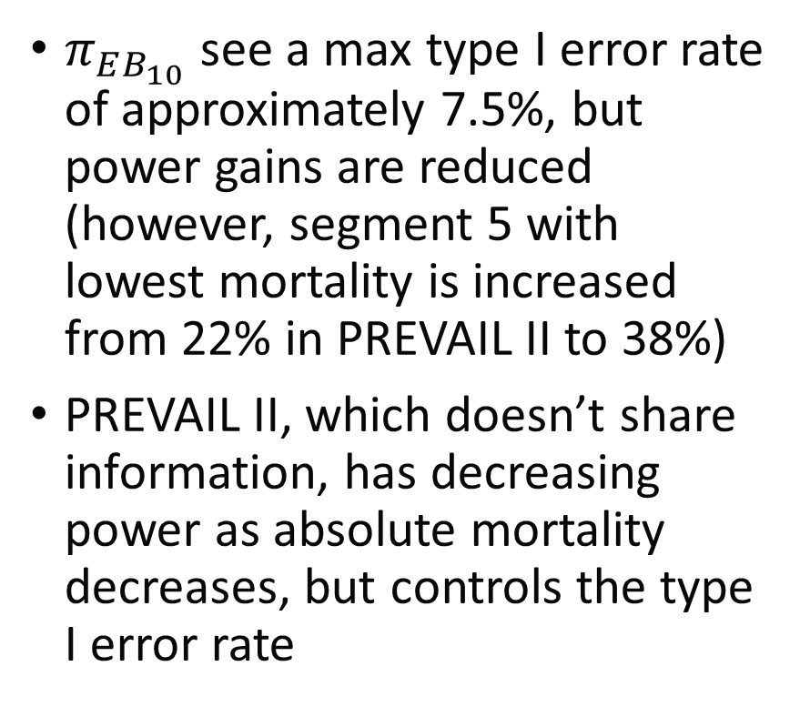
Varying Mortality - II
$π_{EB_{10}}$ see a max type I error rate of approximately 7.5%, but power gains are reduced (however, segment 5 with lowest mortality is increased from 22% in PREVAIL II to 38%)
PREVAIL II, which doesn’t share information, has decreasing power as absolute mortality decreases, but controls the type I error rate

Slide 58
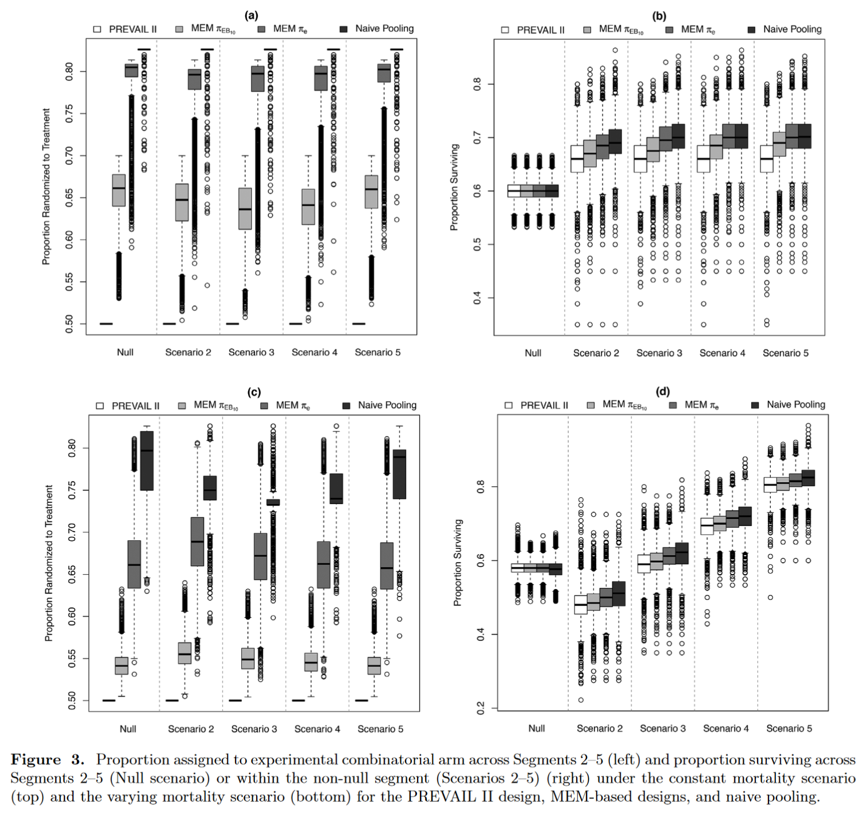
Allocation and Survival Results
Figure 3 from Kaizer (2018) shows boxplots of proportion randomized to treatment (LEFT) and proportion surviving (RIGHT) by constant (TOP) and varying (BOTTOM) scenarios

Slide 59
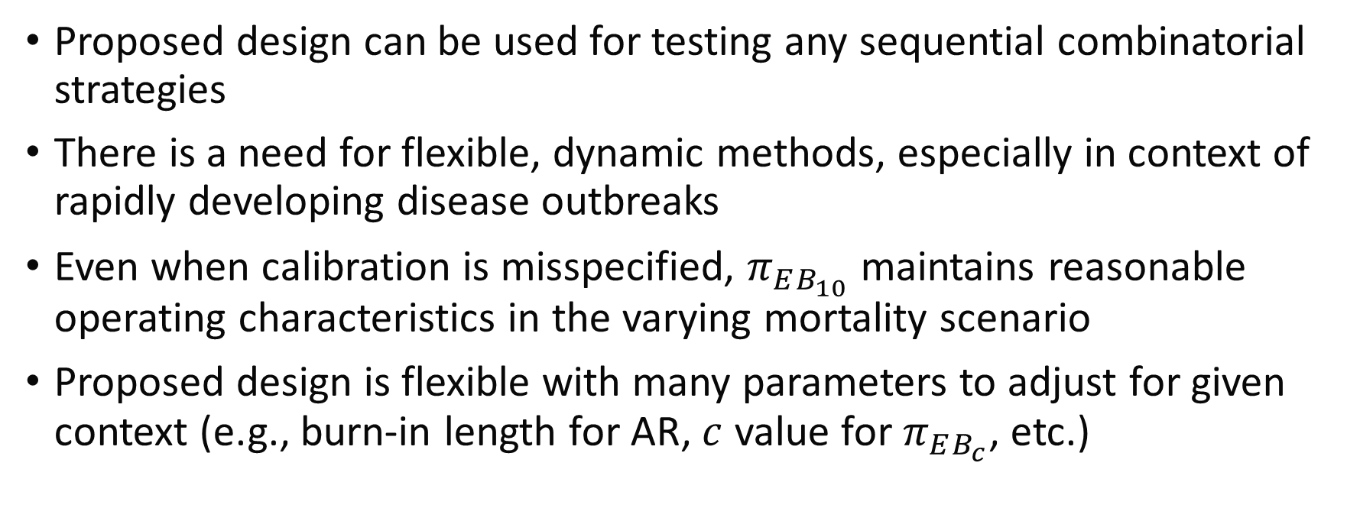
Adaptive Platform Trial Discussion
Proposed design can be used for testing any sequential combinatorial strategies
There is a need for flexible, dynamic methods, especially in context of rapidly developing disease outbreaks
Even when calibration is misspecified, $π_{EB_{10}}$ maintains reasonable operating characteristics in the varying mortality scenario
Proposed design is flexible with many parameters to adjust for given context (e.g., burn-in length for AR, $c$ value for $π_{EB_{c}}$, etc.)

Slide 60
Module Conclusions
Master protocols are extremely flexible statistical designs, allows for what could be multiple separate studies under a single “master” protocol
Some statistical considerations may need more thoughtful discussion than with a traditional trial (e.g., family-wise error control, how to handle non-contemporaneous data)
More commonly used in oncology and infectious disease, but interest expanding more generally
Any of our adaptive elements can be incorporated to the design (e.g., interim monitoring, adaptive randomization, and information sharing in our Ebola virus disease platform trial)

Slide 61
References
Kaizer, Alexander M., et al. "Recent innovations in adaptive trial designs: a review of design opportunities in translational research." Journal of Clinical and Translational Science (2023): 1-35.
Woodcock, Janet, and Lisa M. LaVange. "Master protocols to study multiple therapies, multiple diseases, or both." New England Journal of Medicine 377.1 (2017): 62-70.
Renfro, L. A., & Sargent, D. J. (2017). Statistical controversies in clinical research: basket trials, umbrella trials, and other master protocols: a review and examples. Annals of Oncology, 28(1), 34-43.
West, Howard Jack. "Novel precision medicine trial designs: umbrellas and baskets." JAMA oncology 3.3 (2017): 423-423.
Kim, Edward S., et al. "The BATTLE trial: personalizing therapy for lung cancer." Cancer discovery 1.1 (2011): 44-53.
Heinrich, Michael C., et al. "Phase II, open-label study evaluating the activity of imatinib in treating life-threatening malignancies known to be associated with imatinib-sensitive tyrosine kinases." Clinical Cancer Research 14.9 (2008): 2717-2725.
Dodd, Lori E., et al. "Design of a randomized controlled trial for Ebola virus disease medical countermeasures: PREVAIL II, the Ebola MCM Study." The Journal of infectious diseases 213.12 (2016): 1906-1913.
PREVAIL II writing group, and Multi-National PREVAIL II Study Team. "A randomized, controlled trial of ZMapp for Ebola virus infection." The New England journal of medicine 375.15 (2016): 1448.
Kaizer, Alexander M., Brian P. Hobbs, and Joseph S. Koopmeiners. "A multi-source adaptive platform design for testing sequential combinatorial therapeutic strategies." Biometrics 74.3 (2018): 1082-1094.
Hobbs, Brian P., Bradley P. Carlin, and Daniel J. Sargent. "Adaptive adjustment of the randomization ratio using historical control data." Clinical Trials 10.3 (2013): 430-440.

Slide 62

Contact Info:
Email:
alex.kaizer@cuanschutz.edu
Website: www.alexkaizer.com
GitHub: alexbiostats

